Slide 1
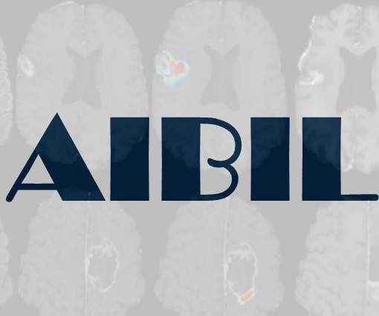
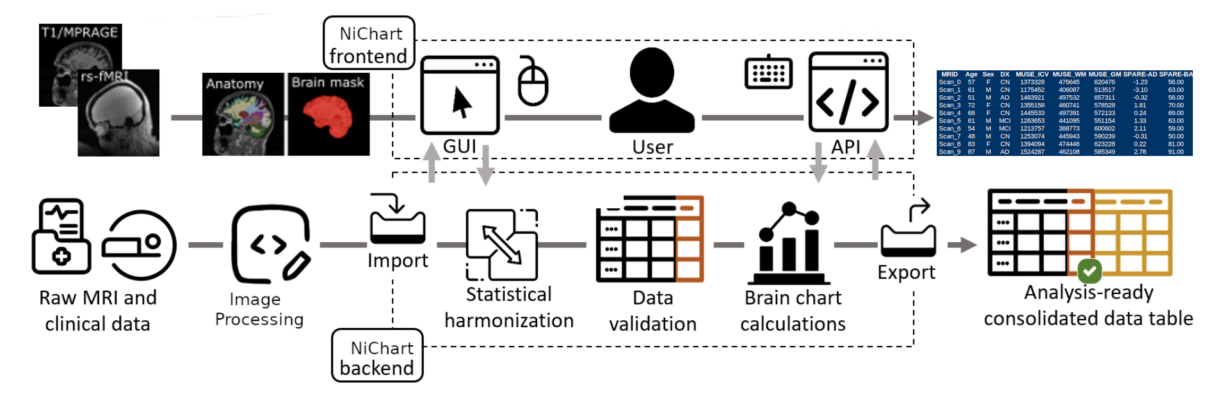
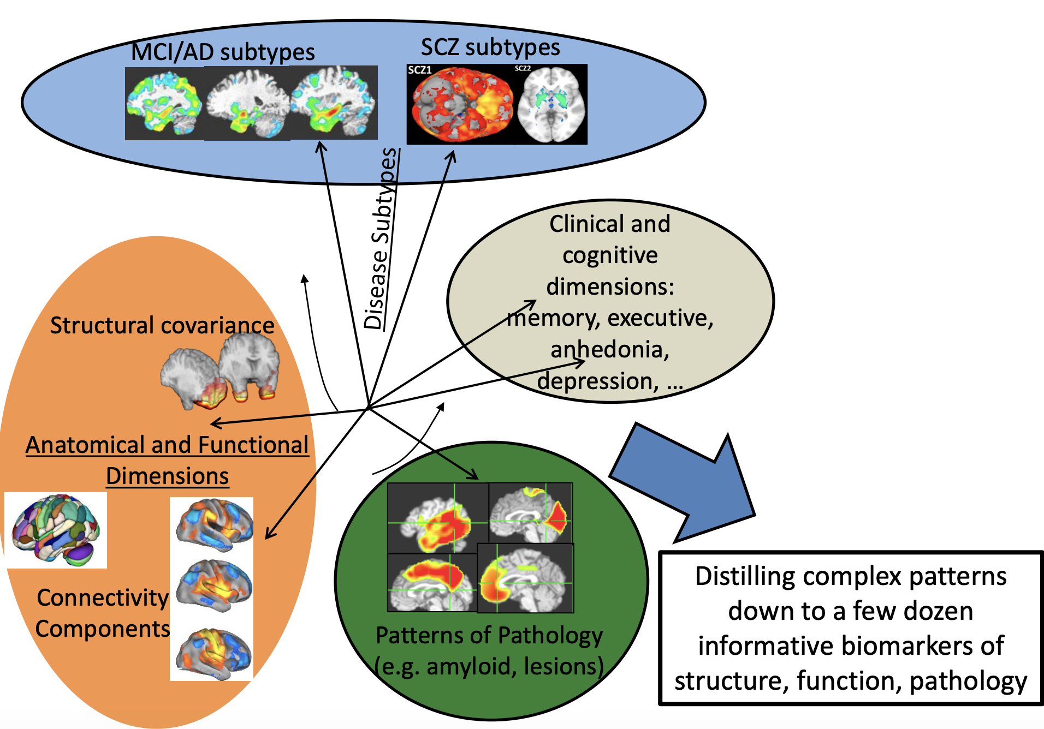

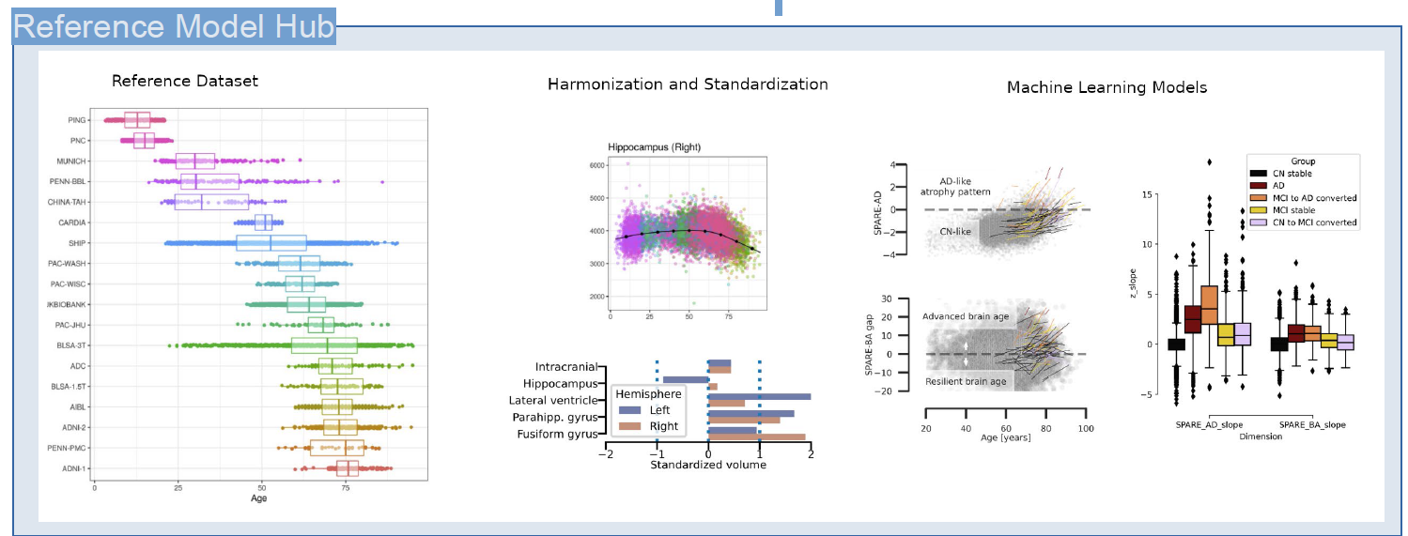
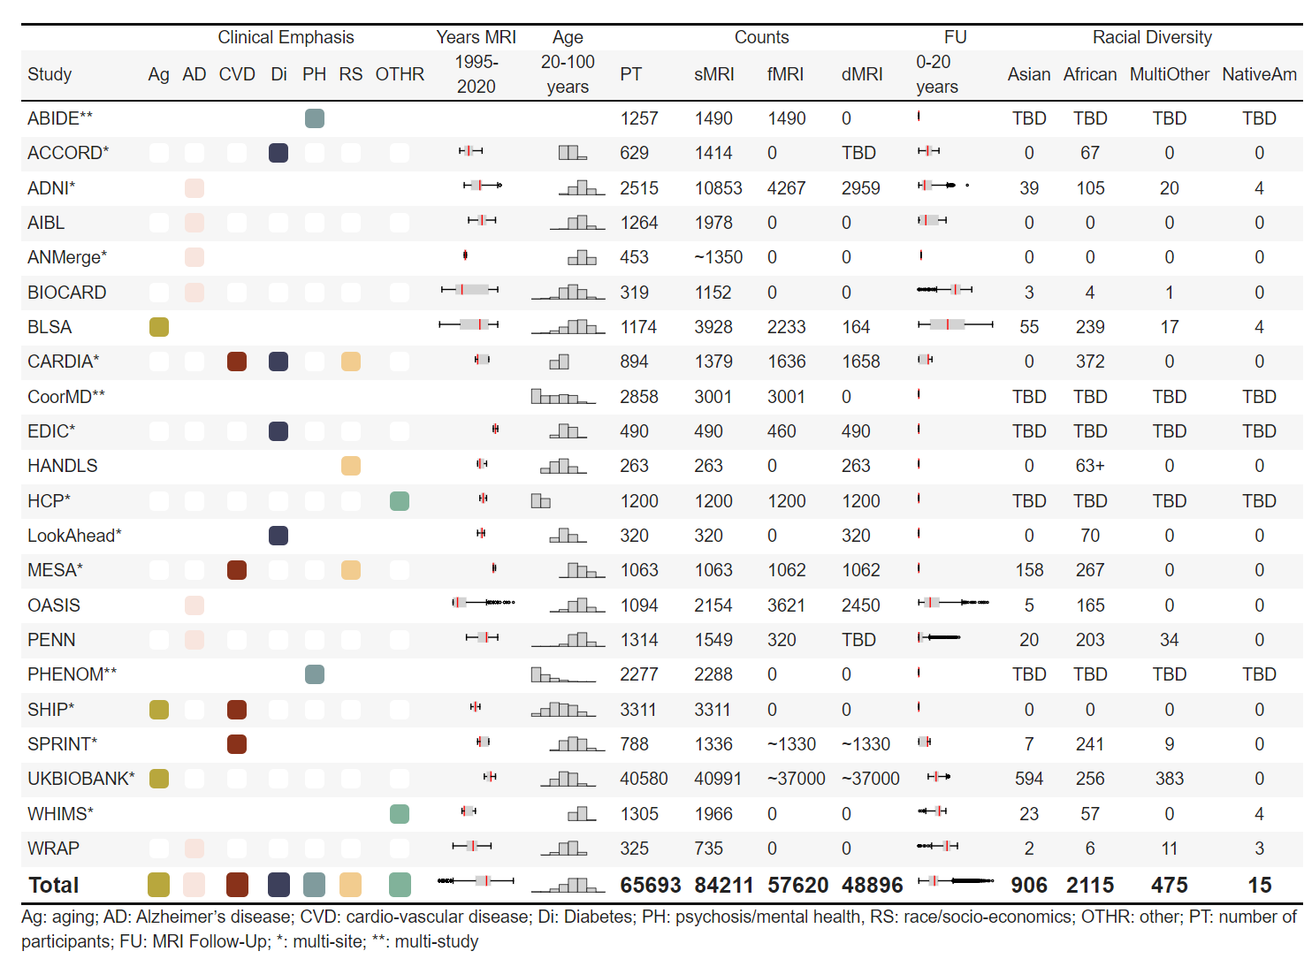
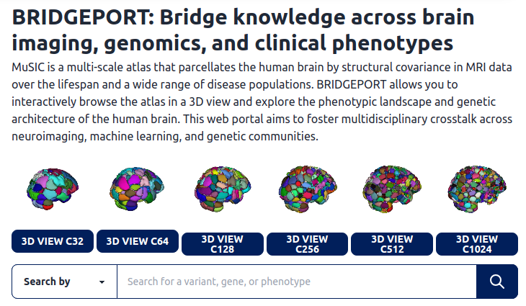
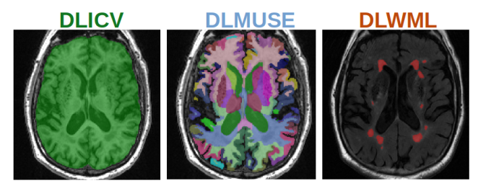
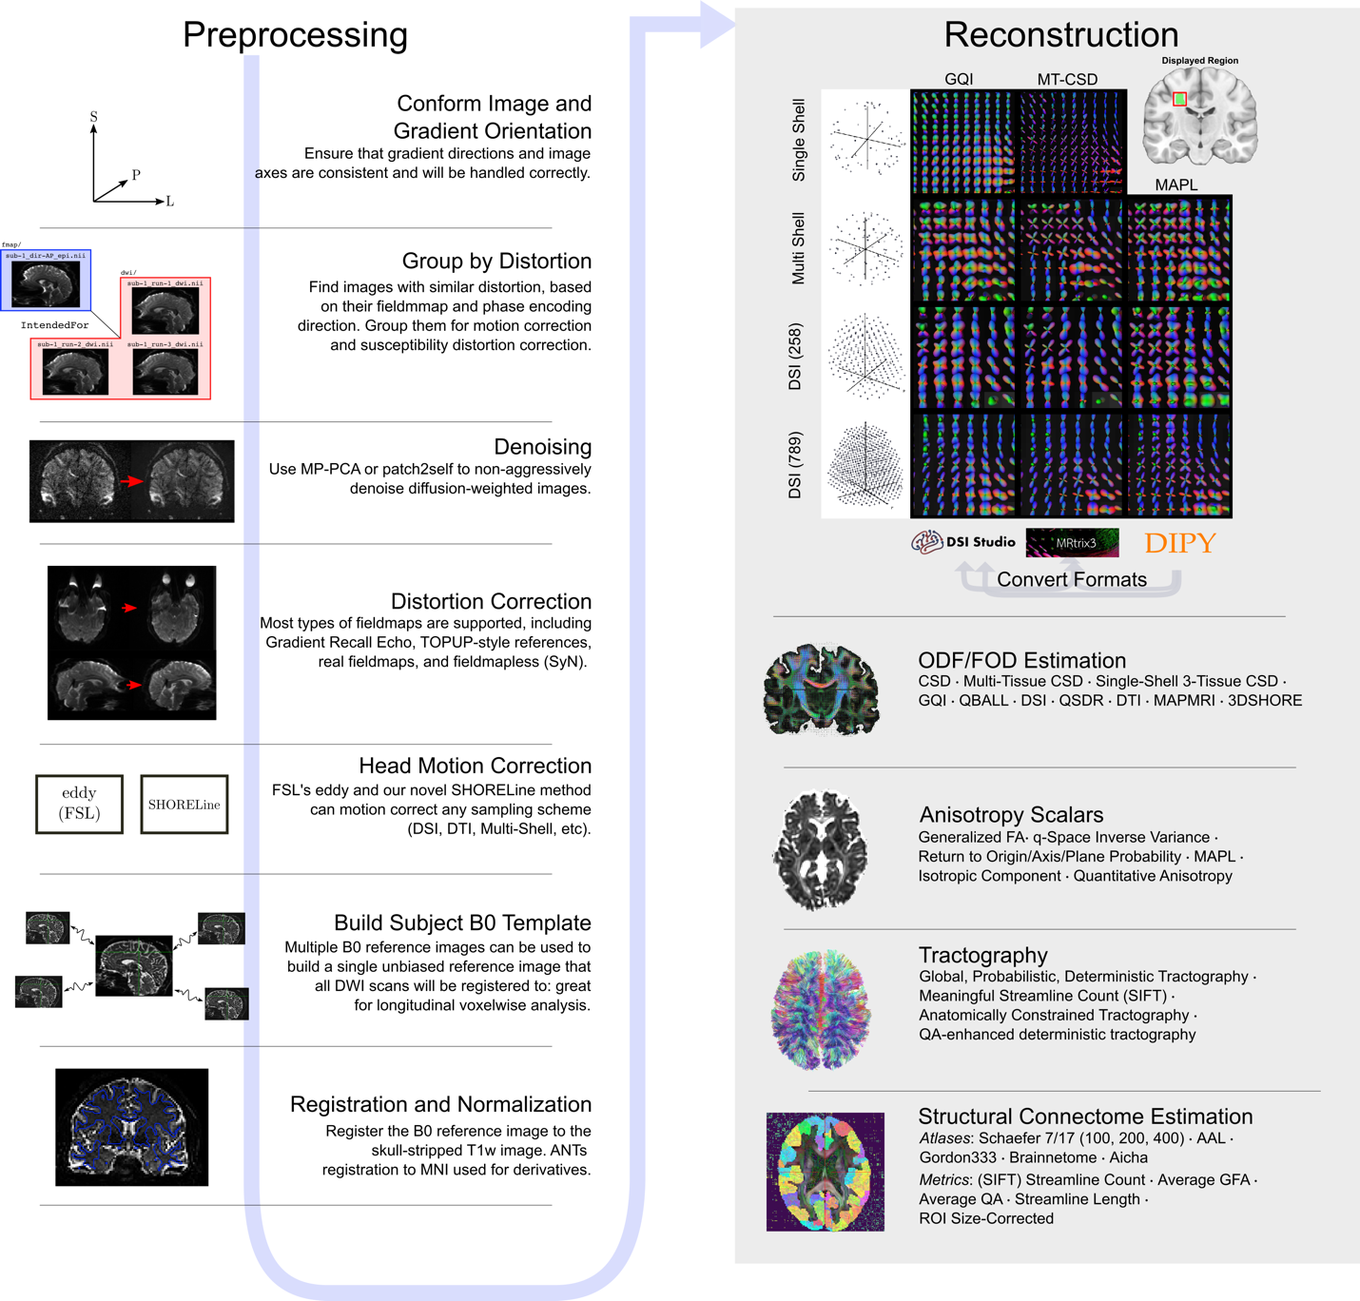
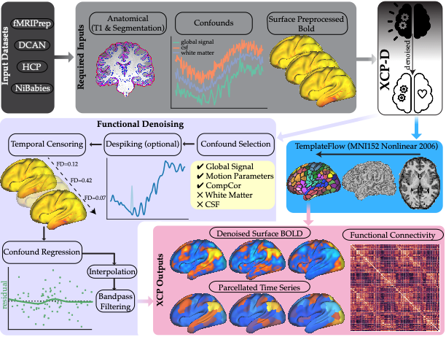
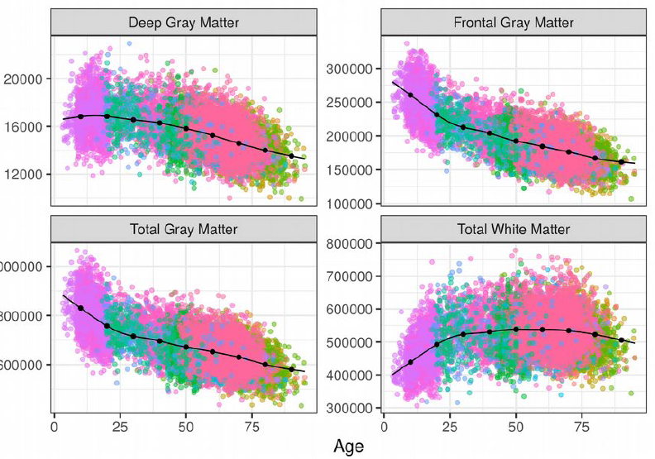
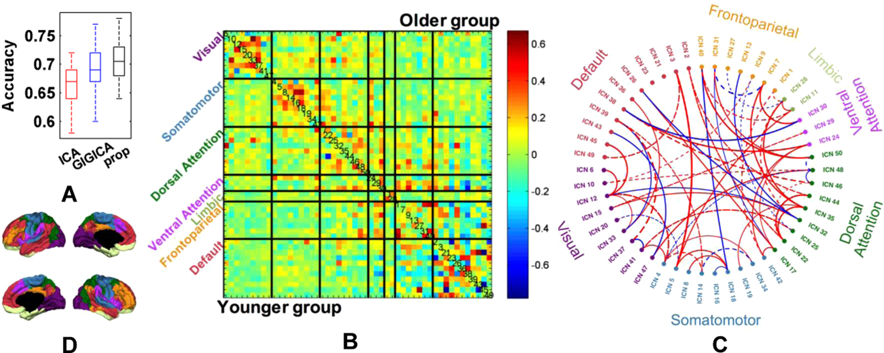
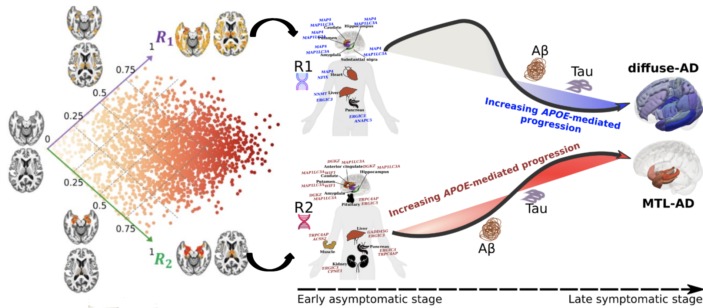
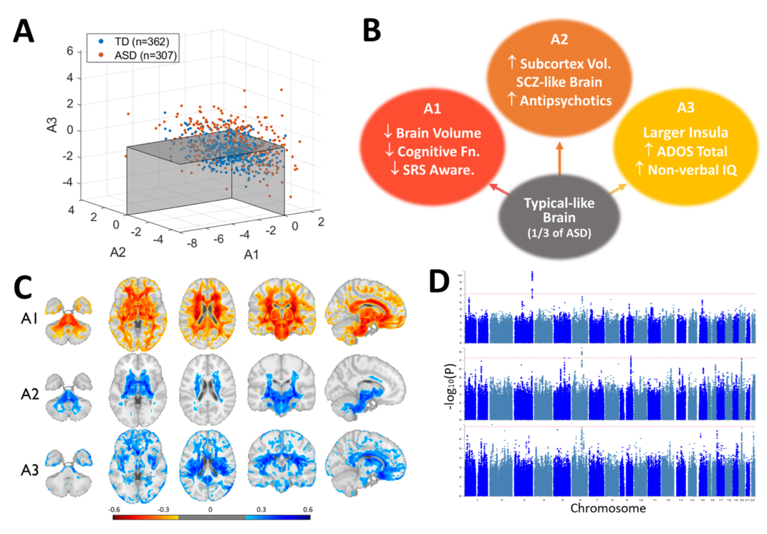
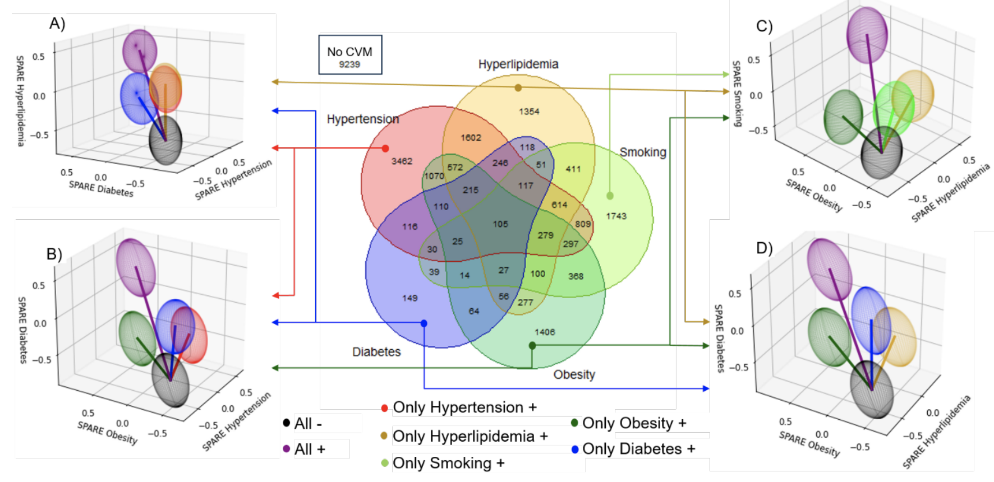

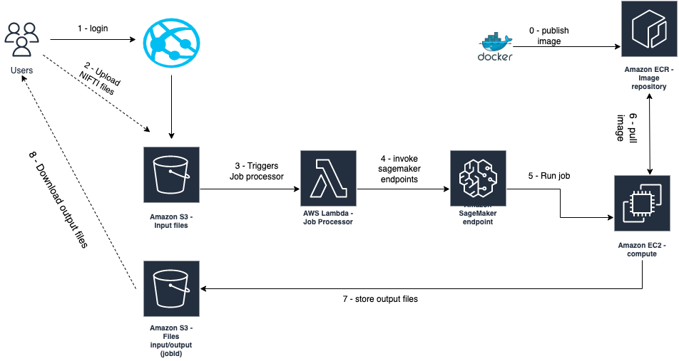
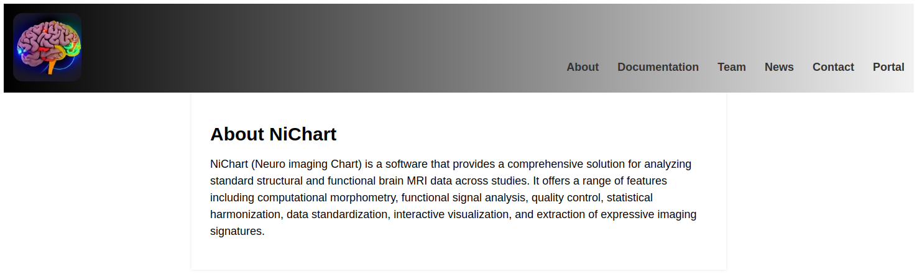

NiCHART: From Neuroimaging Big Data to
Individualized Imaging Signatures of Disease and Aging
ARTIFICIAL INTELLIGENCE
IN BIOMEDICAL IMAGING LAB
https://aibil.med.upenn.edu
Overview:
A framework to process multi-modal MRI and extract rich and accurate imaging descriptors , harmonize to a large reference set , and apply machine learning models trained on the reference set to derive individualized “NeuroImaging Chart” values
Reference Dataset ^{[1]} :
sMRI Processing:
Atlas-based segmentation (DLMUSE) ^{[2]} :
A deep learning method for fast and accurate
segmentation of normal and abnormal anatomy
Data-driven segmentation
(MUSIC) ^{[3]} :
Multi-scale non-negative matrix factorization method for data-driven parcellation of the brain
dMRI and fMRI Processing:
Statistical Harmonization:
QSIPrep ^{[4]}
FMRIPrep ^{[5]}
Personalized functional network (pNet) modeling ^{[6]}
Spline-based COMBAT harmonization using GAM ^{[7]}
GSR-NMF: Group Sparsity Regularized Nonnegative Matrix Factorization
Optimizes functional coherence of functional networks with enhanced interpretability using NMF;
Regularizes the personalized functional networks to have common spatial patterns across subjects through group sparsity
>10,000 downloads
>10,000 downloads
ML models of disease and disease sub-types:
Image heterogeneity models: Early expression along dimensions of AD ^{[8]}
Imaging phenotypes in Autism Spectrum Disorder ^{[9]}
Imaging phenotypes of cardio-metabolic risk factors ^{[10]}
References:
1. Habes M. et. al. The Brain Chart of Aging: Machine-learning analytics reveals links between brain aging, white matter disease, amyloid burden, and cognition in the iSTAGING consortium of 10,216 harmonized MR scans. Alzheimers Dement. 17(1):89-102. (2021)
NiChart Software:
Open development on GitHub
Modular design with independent software components
Software deployment to accommodate different needs and use case scenarios:
Python installation packages through PIP
Reproducible Docker and Singularity containers.
Web application on AWS.
2. Doshi, J., et al. DeepMRSeg: A conv. deep neural network for anatomy and abnormality segmentation on MR images. arXiv preprint arXiv:1907.02110 (2019).
3. Wen J. et. al. Novel genomic loci influence patterns of structural covariance in the human brain. PNAS. 2023
4. Ciric, R. et. al. Mitigating head motion artifact in functional connectivity MRI. Nature Protocols. 13. 2801–2826 (2018)
5. Cieslak, M. et al. QSIPrep: an integrative platform for preprocessing and reconstructing diffusion MRI data. Nat Methods 18, 775–778 (2021)
6. Zhou, Z. et al. Multiscale func. conn. patterns of the aging brain learned from harm. rsfMRI data of the multi-cohort iSTAGING study. NeuroImage 269 (2023)
7. Pomponio, R. et al. Harmonization of large MRI datasets for the analysis of brain imaging patterns throughout the lifespan. NeuroImage 208 (2020)
8. Yang, Z. et. al. A DL framework identifies dimensional representations of Alzheimer’s Disease from brain structure. Nature Communications. 12. (2021)
9. Hwang G, et. al. Assess. of neuroanat. endophenotypes of ASD and assoc.with char. of individuals with SCZ. JAMA Psychiatry. 80(5) (2023)
10. Govindarajan, S.T., et. al., Machine-learning based MRI neuro-anatomical signatures associated with cardiovascular and metabolic risk factors. Submitted to JAMA.
Links:
https://aibil.med.upenn.edu/software/#nichart
AWS web application architecture

